Slide 1
Pembelajaran Mesin dan Pembelajaran Mendalam #1 Introduction to Machine Learning
Semester Gasal 2024/2025
Prodi Informatika
Universitas Atma Jaya Yogyakarta

Slide 2
Overview
Introduction to Machine Learning
Data representation
k-Nearest Neighbors (a simple explanation)
Generalization, overfiting, and underfitting

Slide 3
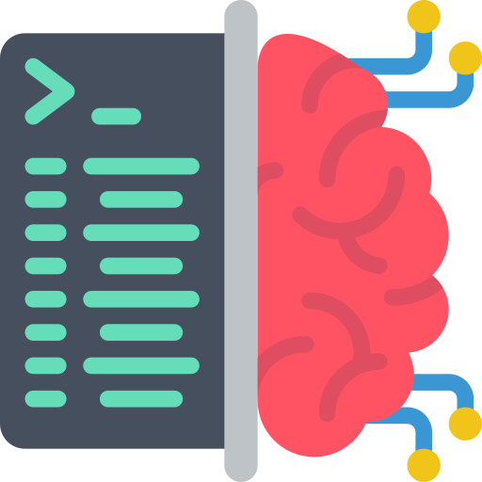
Introduction to Machine Learning

Slide 4
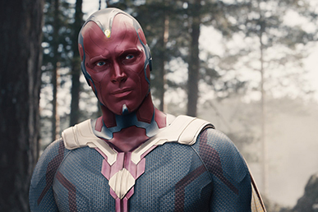
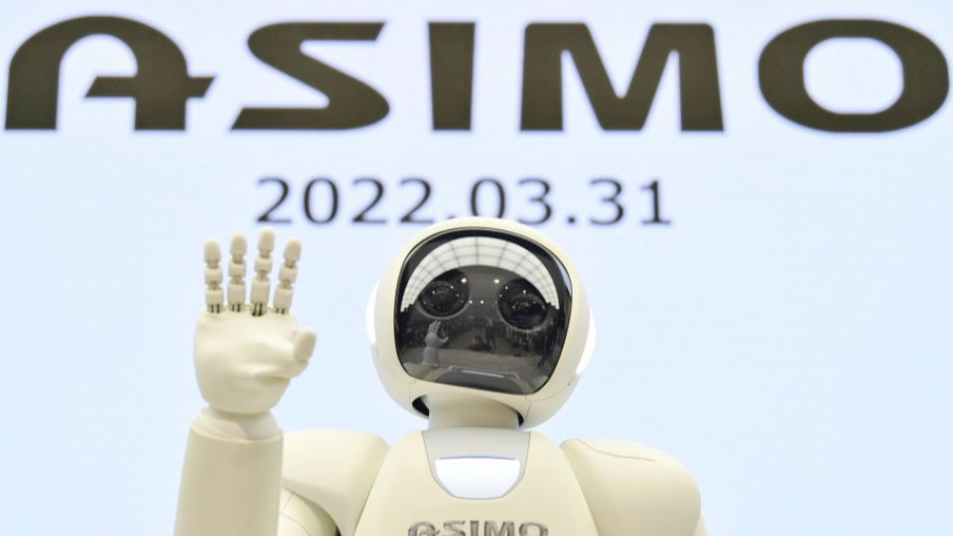
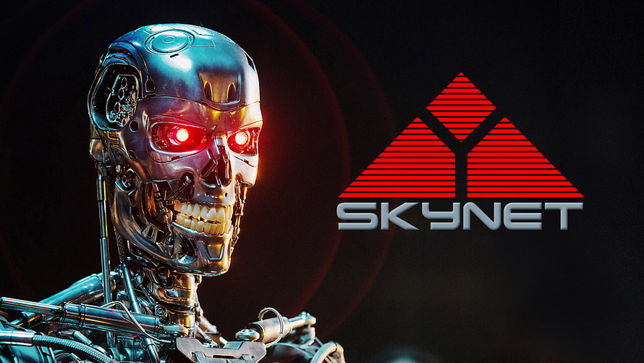
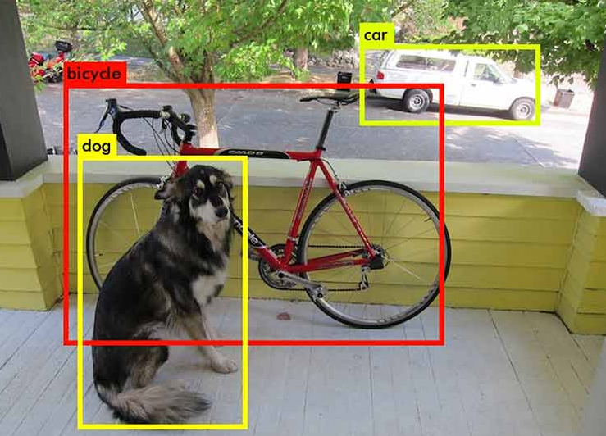
What is Artificial Intelligence?

Slide 5





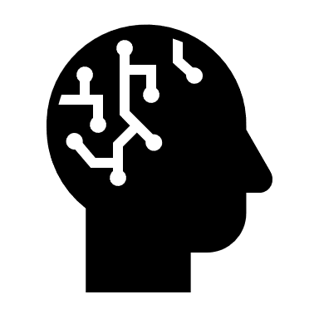
What is Artificial Intelligence?
Input: Data Sensors Images
Artificial Intelligence
Output: Action Movement Text
Notes:
But what is Artificial Intelligence. In general, it is the ability for a machine to perform tasks that would normally require a person to do. And just like people, it’s the ability to take information, make decisions based on it and cause an action to be taken. Such as moving an arm, creating and image or text, or providing a suggestion.

Slide 6
Types of Artificial Intelligence
Artificial Superintelligence: An intellect that is much smarter than the best human brains in practically every field, including scientific creativity, general wisdom and social skills.
Artificial General Intelligence: A machine with the ability to apply intelligence to any problem, rather than just one specific problem (human-level intelligence)
Artificial Narrow Intelligence: Machine intelligence that equals or exceeds human intelligence or efficiency at a specific task
Notes:
So if that’s the basic idea of artificial intelligence, are we really talking about Skynet or Hal 9000?
A bit. Where researchers talk about AI, there may be different type of intelligence they could be referring to. Artificial Super intelligence is the pinnacle. It’s the kind of thing that we see in sci-fi and would end up being a god like intellect. It’s something that would far outpace human capabilities in the same way we outpace insects. But that’s very hypnotical for now. Bering things closer to reality is the story of Artificial General Intelligence. The key here is that it’s a general purpose machine that can apply its skills to any problem. In a similar way as person could be trained to do most things. They are not built for specific tasks. This is the goal for research at the moment and we may be slowly moving closer.
But let’s bring things down to the type of Artificial Intelligence you may already see in the word. The are all examples of Artificial Narrow Intelligence. That is, it’s a machine that is designed to be good at one specific task. It may be complex, like driving a car, or fairly simple like identifying spam emails. But it is still quite a narrow skillset.

Slide 7
(some) Subsets of Artificial Intelligence
Artifical
Artificial Intelligence
Machine Learning is a subset of Artificial Intelligence
Machine Learning
Deep Learning
Deep Learning
is a subset of
Machine Learning
Deep Learning uses neural networks to simulate human like decision making
Notes:
There are many tools and approaches that have been developed to help get us closer to the goal of artificial intelligence, but some of them have been getting much more attention recently A couple of terms you tend to hear in combination with Artificial Intelligence these days is Machine Learning and Deep Learning.
These are methods and tools used in developing applications of Artificial Intelligence. Let’s look at them a bit more in depth

Slide 8
What’s Machine Learning?
Machine learning is about extracting knowledge from data
a research field at the intersection of statistics, artificial intelligence, and computer science
also known as predictive analytics or statistical learning

Slide 9
What is Machine Learning
Type of Artificial Intelligence that provides computers with the ability to learn without being explicitly programmed
Various techniques can be used to for it learn make predictions based on data
Training Data
Machine Learning Algorithm
Training
Prediction
“Live” Data
Trained Model
Prediction
Notes:
First off, we have machine learning. So, for our Artificially Intelligent machine to know how to behave, it has to be taught what to do. In the past, this was done by programming individual skills manually. But, as you can guess, this was quite a labour and skill intensive process. Over time, researchers developed methods to allow machines to learn by themselves. There are various approaches, but in general they have the same thing in common. Initially, a machine learning algorithm (a program that allows the machine to learn) is provided with large amounts of data that allows it to develop rules based on the data it sees. To be trained. These rules are tested and once the developers are happy that the algorithm is providing the appropriate responses it is released to the next stage. The trained model is put into production where it is provided with input and it provides outputs that are used in other places in the system.
For all this, we need data. But the type of data available may inform what method we’re able to use for this training.

Slide 10
Why Machine Learning?
In the early days of “intelligent” applications, many systems used hand coded rules of “if ” and “else” decisions to process data or adjust to user input
Using hand coded rules to make decisions has two major disadvantages:
the logic required to make a decision is specific to a single domain and task
changing the task even slightly might require a rewrite of the whole system
designing rules requires a deep understanding of how a decision should be made by a human expert

Slide 11

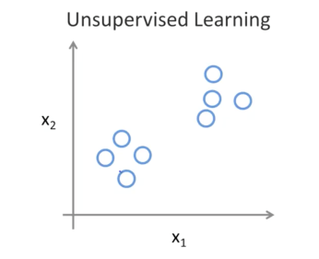
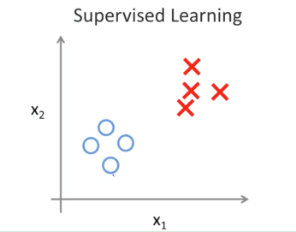
Machine Learning Approaches
Supervised Learning: Learning with a labelled training set
Example: email spam detector with training set of labelled emails
Unsupervised Learning: Discovering patterns in unlabelled data
Example: cluster similar documents based on the text content
Reinforcement Learning: learning based on feedback or reward
Example: learn to play chess by winning or losing
Notes:
There are a couple general approaches to training a Machine Learning model. The most traditional would use a large set of well labelled data. So for example if you’re training an AI to detect spam emails, you’d provide it with lots and lots of emails where the spam messages have been identified. The model would then be able to learn the unique features that make an email be more likely to be spam.
If a labelled data set is not available, it’s possible to look at patterns within a large amount of information. This could help combine sets of customers into similar groups, or find songs that you may like.
Another approach is to give the model some success criteria, like navigating an obstacle course or winning a game, and let it figure out the best way to do that by either winning or losing after each attempt.
But how do these models actually train themselves to do this classification or identification. That’s where deep learning comes in.

Slide 12
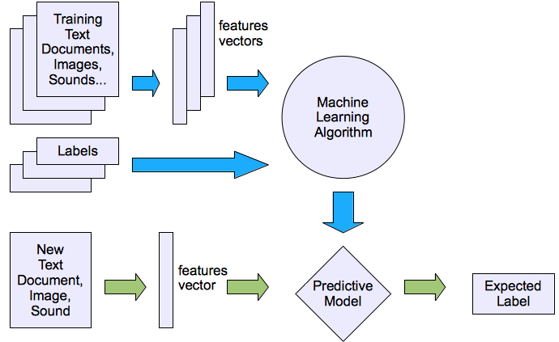
Machine learning structure
Supervised learning

Slide 13
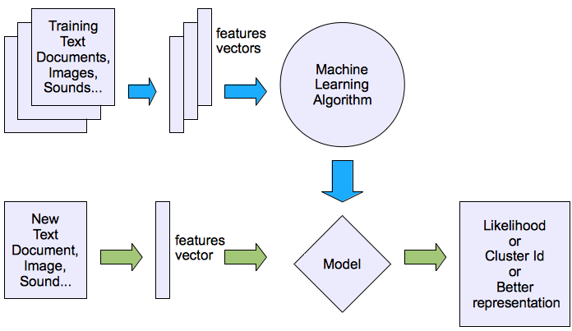
Machine learning structure
Unsupervised learning

Slide 14
Where is Machine Learning Applied?
https://youtu.be/ukzFI9rgwfU?si=ds-TsPP4ggr1urZZ

Slide 15
Choosing an algorithm
No single classifier performs best in all cases, according to David H. Wolpert's no free lunch theorem (The Lack of A Priori Distinctions Between Learning Algorithms, 2004).
To choose the best model for a given problem, it is usually advised to compare the results of at least a few different learning algorithms.
Ultimately, a classifier's performance—both computational and predictive power—relies greatly on the underlying data that is available for learning.

Slide 16
Choosing an algorithm
The next five basic steps can be summed up as training a supervised machine learning algorithm:
1. Choosing features and gathering labeled training examples
2. Selecting an evaluation metrics
3. Selecting an algorithm and developing a model
4. Assessing the model's effectiveness
5. Modifying the algorithm's settings and fine-tuning the model.

Slide 17
Data Representation

Slide 18
Dataset
Machine learning models learn information from datasets.
A simple dataset is in the form of a table with rows and columns.
Rows are samples or entities; columns are features or characteristics.
A label or class or target is a type of entity.
Example of an Iris flower dataset. The row or entity is the Iris flower whose characteristics are recorded.
Columns or features are the results of measurements of the flower petals and crowns which are recorded as distinguishing characteristics between Iris flower species.
The label or target is the species or type of Iris flower.

Slide 19
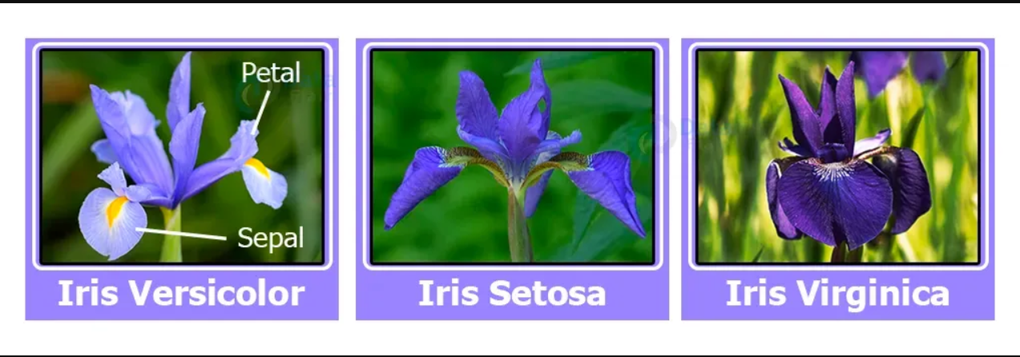
Iris Dataset

Slide 20
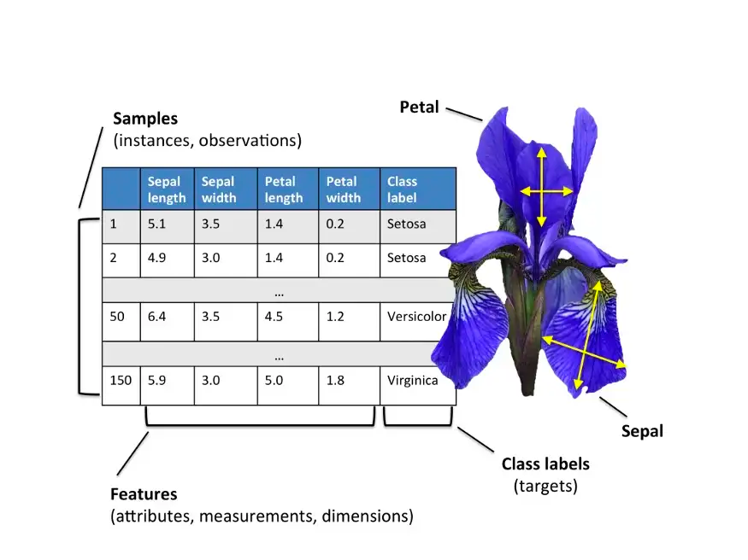
https://eminebozkus.medium.com/exploring-the-iris-flower-dataset-4e000bcc266c

Slide 21
Data Representation
No machine learning algorithm will be able to make a prediction on data for which it has no information
Sample
entity or row
Ex: Users, images of tumor
Feature
properties that describe entity or column
Ex: users have age, gender, account created time, and bought frequency, etc.
Ex: images of tumor consists of grayscale values of each pixel, size, shape, and color of the tumor

Slide 22
k-Nearest Neighbors (a simple explanation)

Slide 23
K-Nearest Neighbors
The KNN algorithm is "lazy" because it does not work by learning functions that can form decision boundaries from data.
KNN learns from the training set by memorizing.
The KNN algorithm has the following working steps:
Selects the number k and the distance measurement method
Looking for k nearest neighbors from the train data set
Perform class predictions by voting the majority of the closest class for new data

Slide 24
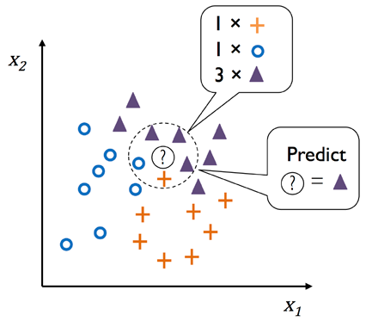
KNN Illustration
K Nearest Neighbors | Intuitive explained | Machine Learning Basics

Slide 25
K-Nearest Neighbors
Based on the distance measurement method chosen, KNN finds a number of k data in the train set that are close to or most similar to the points we want to classify.
The class label of the data point is determined by the highest number of votes among the k nearest neighbor data.
The choice of the right k value is very important to overcome overfitting and underfitting.
We must ensure that the selected measurement method is appropriate for the features of the dataset.
Ex: using the Euclidean method requires data standardization so that each feature contributes equally to the distance measurement.

Slide 26
K-Nearest Neighbors
The advantages of KNN are:
Easy to apply for simple cases
Quite reliable on unbalanced datasets
Simple model training process
The disadvantages of KNN are:
If the train set is large, the training process will take longer
Very sensitive to outliers in calculating the distance between data points
Cannot take into account the level of relevance or significance of features, if there are many features that are less important it will interfere with the learning process of the KNN model

Slide 27
Generalization, Overfitting, dan Underfitting

Slide 28
Generalization
Supervised learning allows us to make precise predictions from new data that shares the same traits as the training set.
To generalize from the training set to the test set, a model must be able to make precise predictions on previously unobserved data.

Slide 29
Overfitting & Underfitting
Overfit: Building a model that is too complex for the amount of information we have
when you fit a model too finely to the specifics of the training set and get a model that performs well on the training set but cannot generalize to new data
decreased accuracy of the test set
Underfit: Choosing a model that is too simple
The model cannot capture all aspects and variability in the data, and your model will perform poorly even on the Training set
Train set and test set accuracy is equally bad
The more variations of data points there are in your dataset, the more complex the model you can use without overfitting

Slide 30
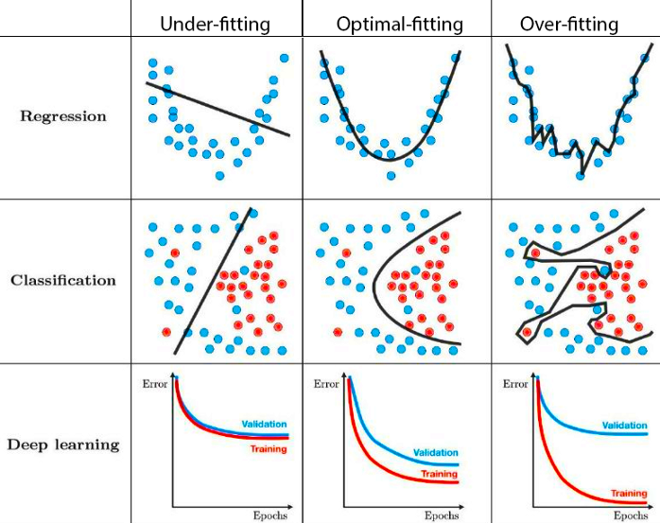
How ML models perform
https://www.kaggle.com/discussions/getting-started/166897

Slide 31
Generalization, Overfitting, & Underfitting

Slide 32
Underfitting & Overfitting - Explained
https://youtu.be/o3DztvnfAJg?si=YG0RO-qc5q4F-dDF

Slide 33
Machine and Learning?

Slide 34
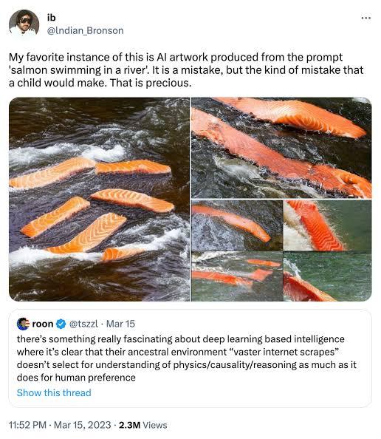
Please be careful

Slide 35

Now, it’s improved

